Slide 1

Basket Dash
By Dom, Jack, James, Michael, Olivia

Slide 2
Game Concept
Fruit races down a track to a basket at the end in a lap based mode, after 3 laps around the track the first person the reach the end basket wins.
With up to 4 players competing against each other, they must dodge traps and obstacles in order to keep up their speed and win.

Slide 3
Features
Up to 4 playable characters that you and your friends can go head to head with.
Traps to avoid as you race towards the goal.
Physics based rolling fruit.
Phone app for extra players / controllers.
Power ups for players to use to change up the race.

Slide 4
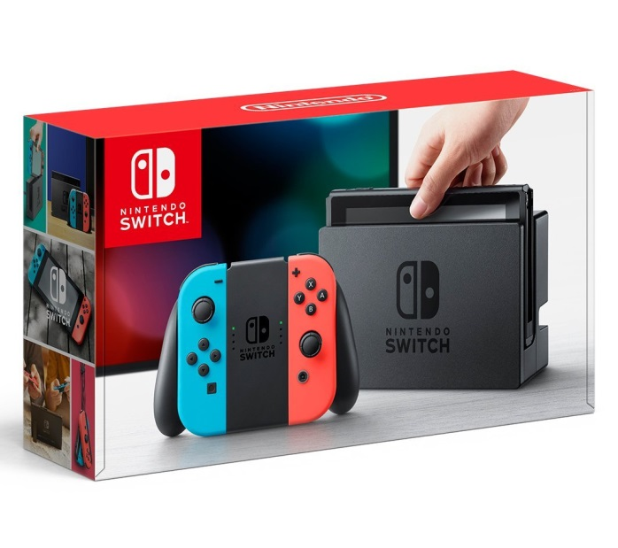
Platform
Nintendo Switch
Simple easy to jump into and quick to play.
Can have 2 - 4 players from the start with only one console, without the need for a second set of controllers.
Good for on the move.
Easy to have friends jump in both locally and online.

Slide 5
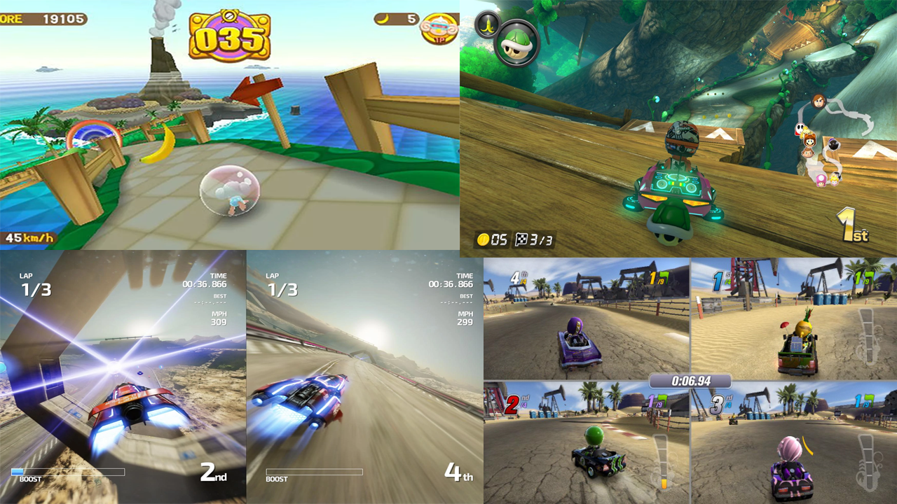
Inspiration / moodboard

Slide 6

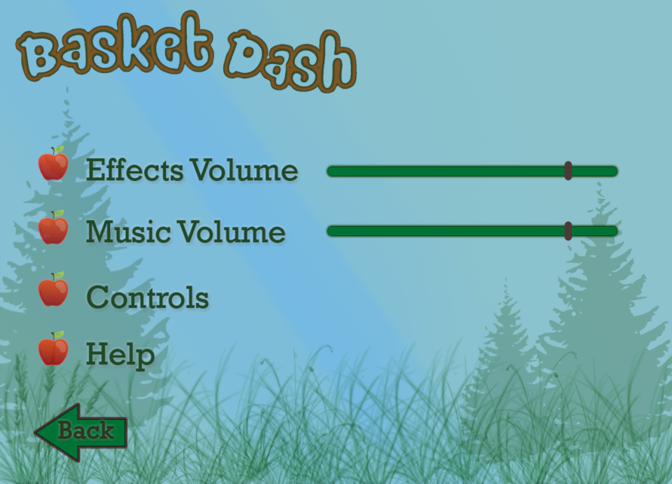

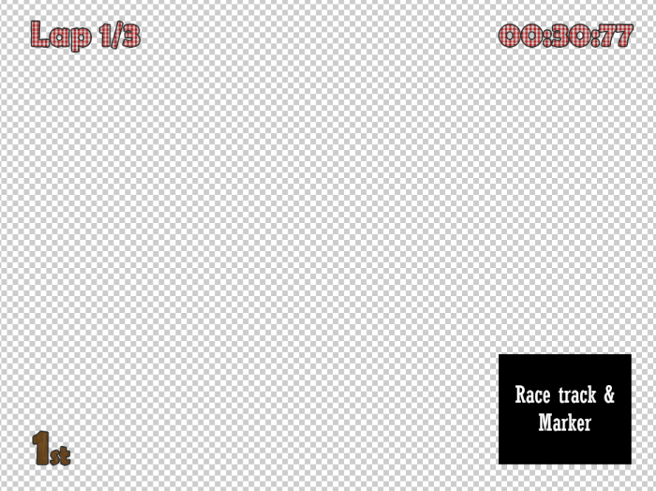
UI Design
Menu screen >
Logo >
< Options menu
< HUD

Slide 7
Target audience
Kids aged 7 – 15
We chose this target audience due to the cell shaded and cartoony aesthetic.
This also suits our target console of the switch.

Slide 8


How it appeals to the audience
The style we went with.
How we adapted the concept.
What we want our players to get out of the game.

Slide 9
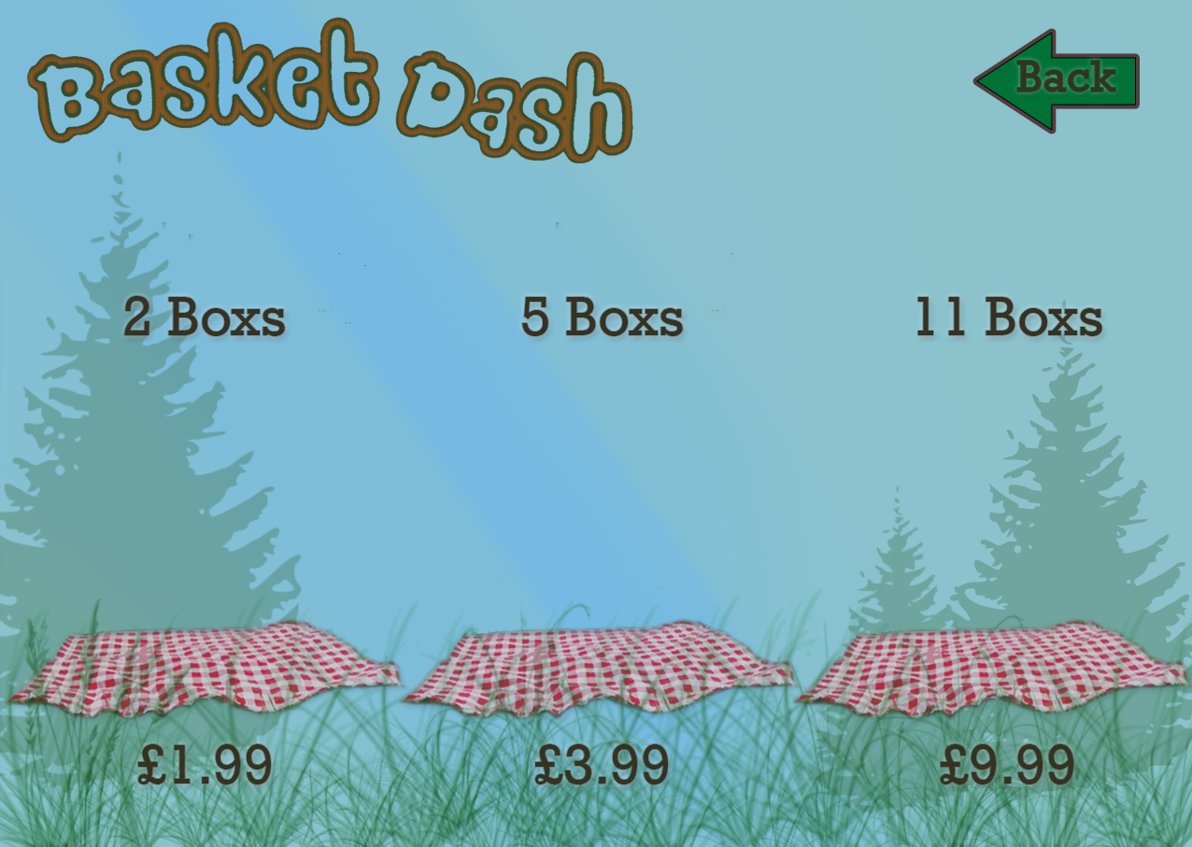
Progression
We plan to use a levelling and points based system, that rewards players with loot boxes / skins as they win races.

Slide 10


Slide 11

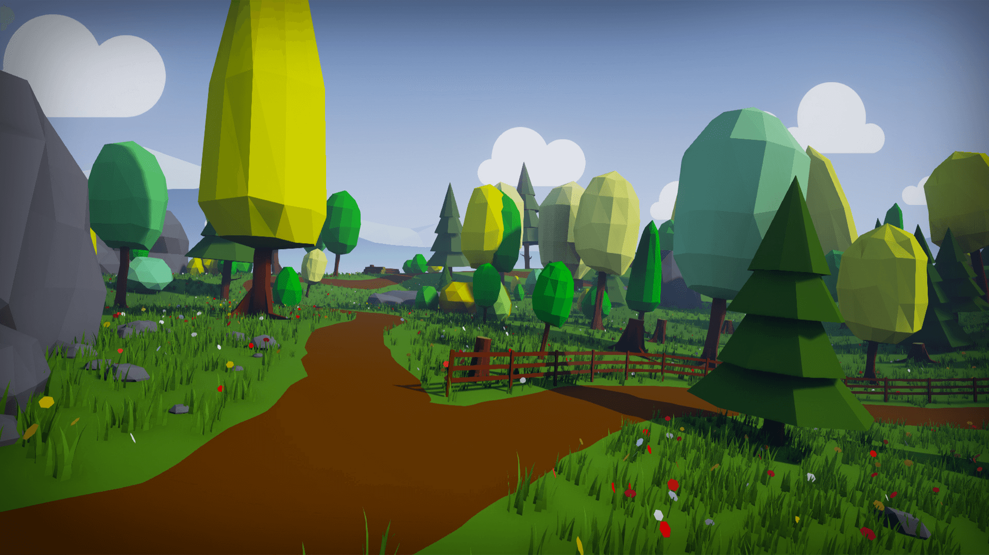
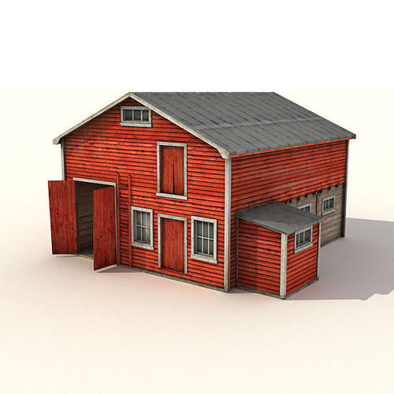
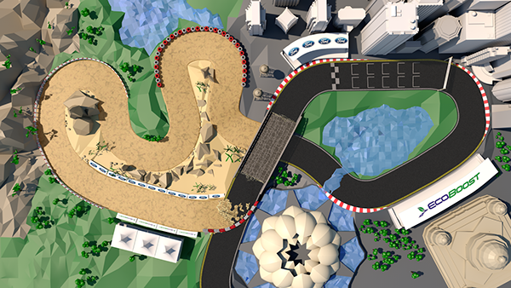
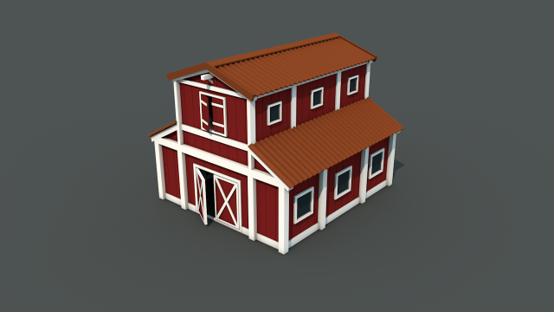
Environment moodboard

Slide 12
Level design and mock up

Slide 13
Market Research
Super Monkey Ball: Banana Blitz (Nintendo Wii):
Released November 19th 2006
8 worlds with 8 stages each and 2 hidden unlockable worlds.
It used the motion controls from the Wii remote to move, making the game difficult to master but precise.
The game had an average review score between a 7 – 8 out of 10. And ranked as one of the top best sellers for the Nintendo Wii.
Mario Kart 8 Deluxe (Nintendo Switch):
Was a re-release and updated version of the Wii version.
It has sold a total of 7.57 million units globally.

Slide 14
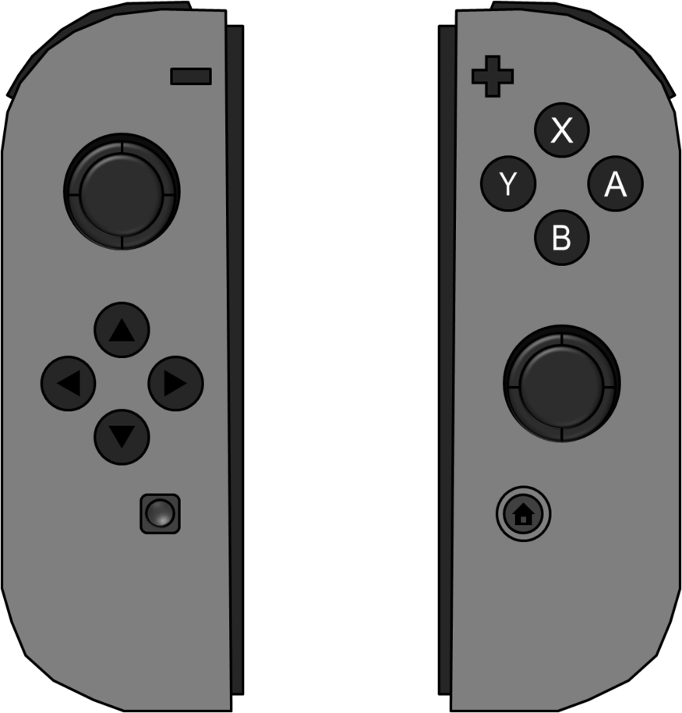




Control Scheme
P1
P2
P3 / 4

Slide 15
Prototype Level

